Slide 1



Data Lake Analytics
Tejaswini Gokanakonda - DE142 Podutur Lahari - DE126

Slide 2

Project Overview
The project involves building a scalable data pipeline using Azure Data Factory (ADF), Azure Data Lake Storage (ADLS), and Azure Databricks.
ADF facilitates data extraction from various sources and moves it to ADLS, where data is organized into raw, curated, and processed zones with logical folder structures and partitioning.
The pipeline ensures secure data handling with Role-Based Access
Control (RBAC) and optimized workflows for querying and analytics. This solution supports real-time and batch processing, enabling actionable insights and business intelligence.

Slide 3

Introduction
Azure Data Lake Analytics is an on-demand analytics service that simplifies big data processing by allowing users to write and execute massively parallelized queries over petabytes of data.
It works seamlessly with Azure Data Lake Storage, enabling data to be processed directly without the need to move or transform it.
This serverless service eliminates the need to provision hardware, scaling resources dynamically based on workload. Ideal for log analysis, ETL processes, machine learning, and real-time analytics, Data Lake Analytics is cost-effective, as users only pay for the processing power they consume.

Slide 4


Dataset Overview
Dataset Source : Kaggle
Customer_ID Age
Gender Occupation Marital Status Family Size Income Expenditure Use Frequency Loan Category Loan Amount Overdue
Debt Record Returned Cheque Dishonour of Bill
Dataset Size : 500 rows and 15 columns
Description:
The dataset contains customer data related to loans, financial behavior, and repayment trends. It includes demographic information, financial metrics, and loan-specific insights, making it ideal for analyzing creditworthiness, financial activity, and loan default risks.

Slide 5
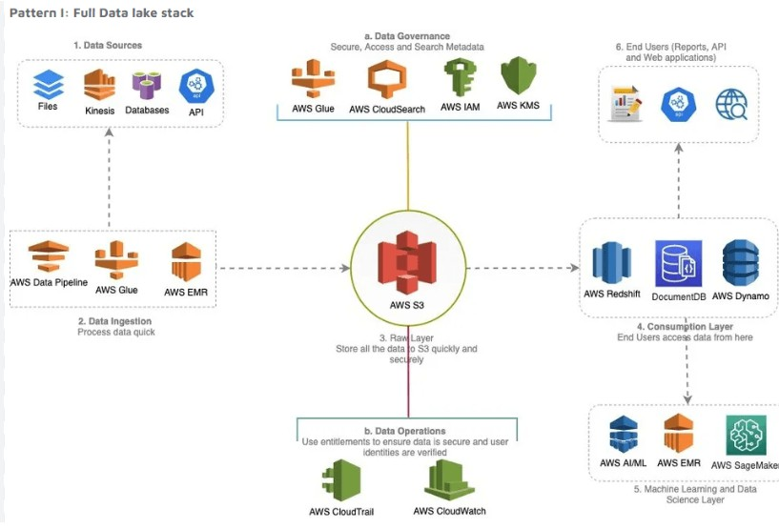
Architecture Diagram

Slide 6

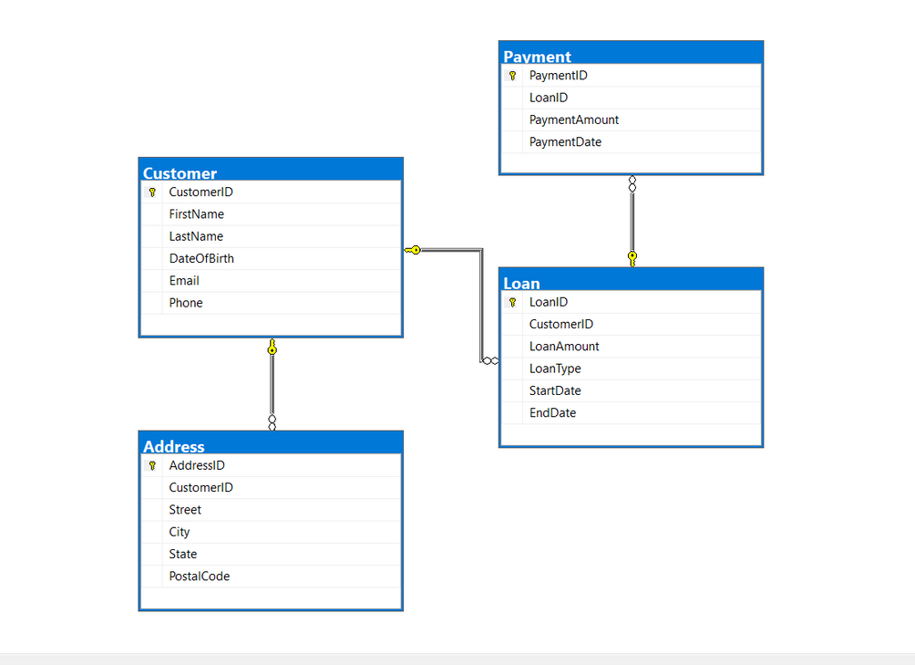
ER Diagram

Slide 7


Execution Overview
The Loan Data Analytics project processes customer loan data by ingesting demographic, financial, and loan-specific information into Azure Databricks. Data is sourced from CSV and JSON files stored in Azure Data Lake Storage or Blob Storage.
Using PySpark, the data is preprocessed and transformed to clean inconsistencies, handle missing values, and calculate metrics like overdue rates, debt-to-income ratios, and customer loan usage trends.
The processed data is stored in Delta Lake for efficient querying and analytics.

Slide 8

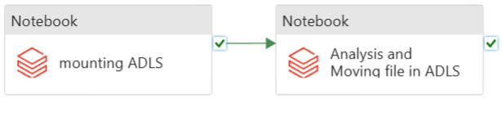
ETL Pipeline

Slide 9



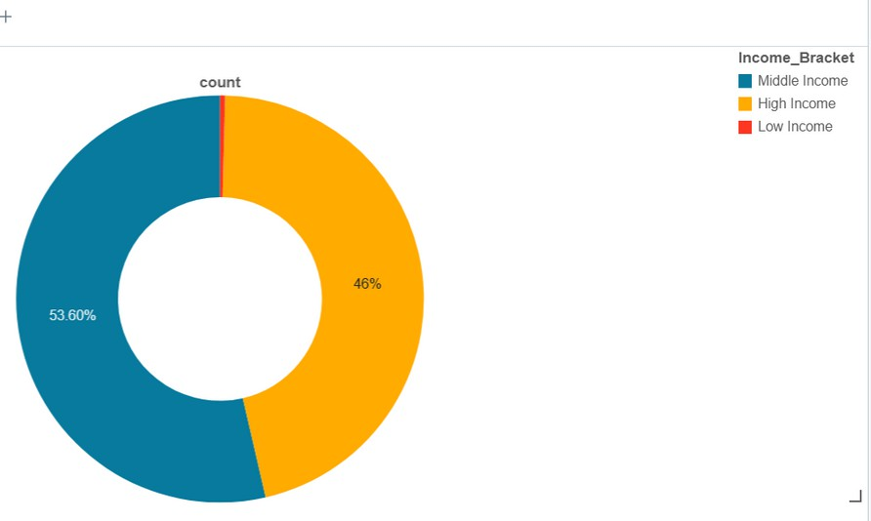
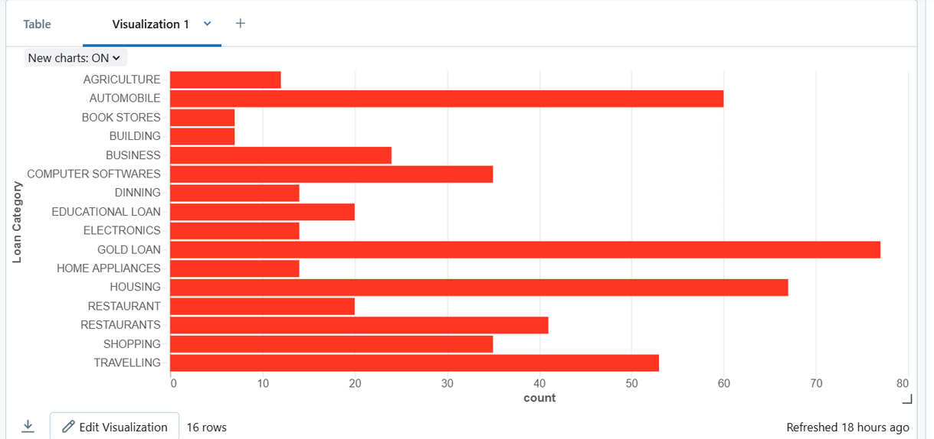
Analaysis Results

Slide 10

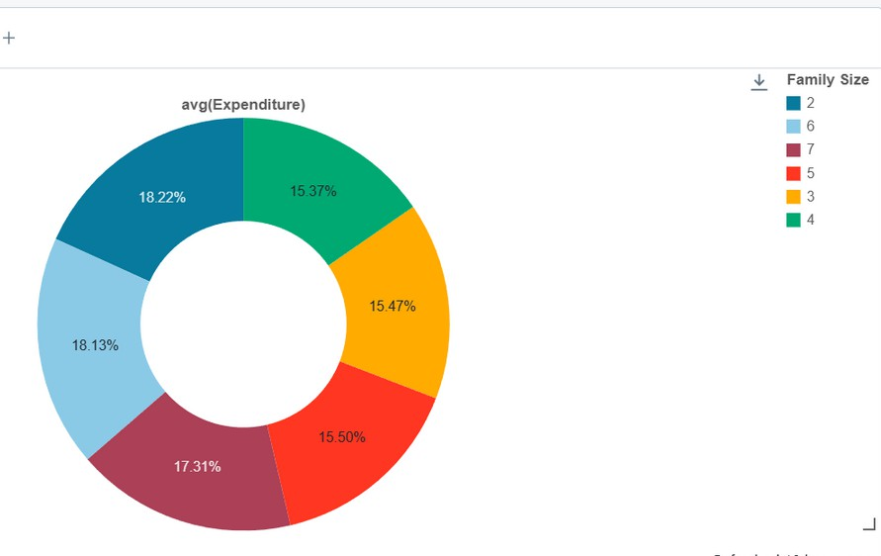

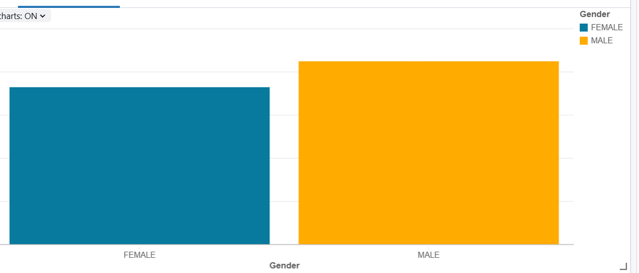

Slide 11

Conclusion
data engineering stack, including Azure Databricks, Data Factory, and Data Lake
The Loan Data Analytics project successfully leverages Azure's modern
Storage, to create a scalable, automated, and efficient pipeline.
By implementing robust ETL workflows, advanced data processing techniques, and seamless visualization through Power BI, this solution enables actionable insights into customer loan behavior, default risks, and financial trends.
This comprehensive system empowers stakeholders with the tools needed for data- driven decisions, ensuring business intelligence and operational efficiency.

Slide 12















